Slide 1
MEDILAB AND DRUGSTORE INFORMATION SYSTEM
DRIVE LINK: https://drive.google.com/file/d/1N0nT3vEvxCU8tRRIWYtQ-HKi00jPKTds/view?usp=sharing
CASE STUDY - 4
1) SOUMYAJIT PRAMANIK (11500119047)
2) TUHIN HAZRA (11500119048)
3) TANDRIMA GHOSH (11500119051)
4) SNEHA TIWARI (11500119052)

Slide 2
Case study title: MediLab & Drug Store Information System
Case study description: MLDIS is a system designed to cater to the needs of a typical test laboratory where patients can go for different types of prescribed tests and also buy prescription drugs.

Slide 3
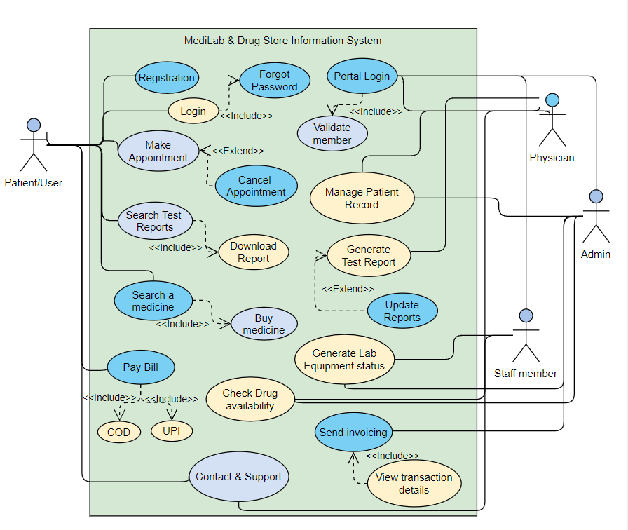
USE CASE DIAGRAM

Slide 4
TECHNOLOGIES USED
HTML/CSS
PHP
MySQL
JavaScript

Slide 5
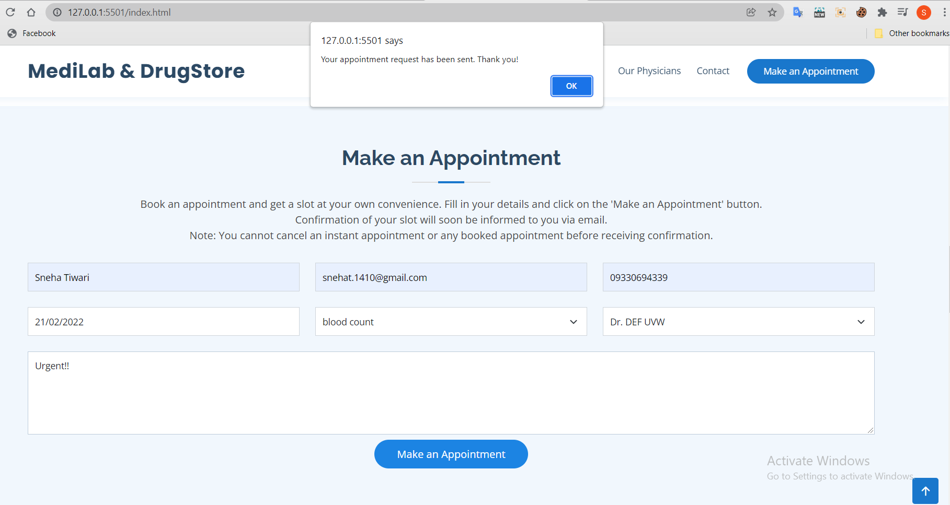
PROTOTYPE IMPLEMENTATIONS
1) MAKE AN APPOINTMENT

Slide 6
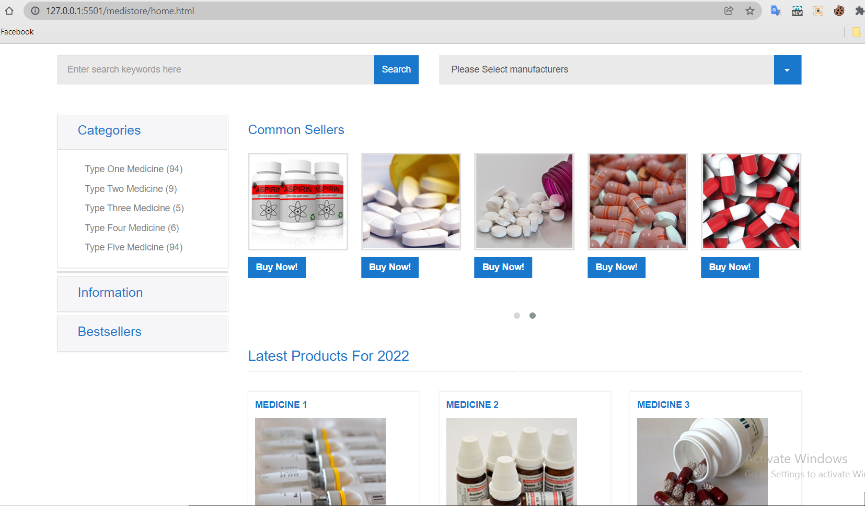
2) SEARCH MEDICINE

Slide 7
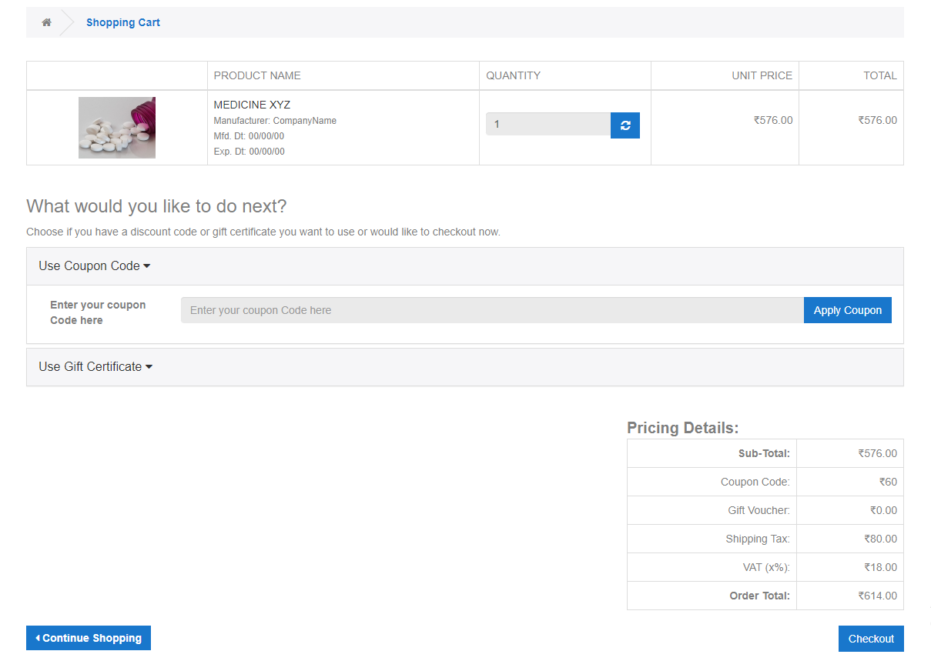
CONTINUED ..

Slide 8
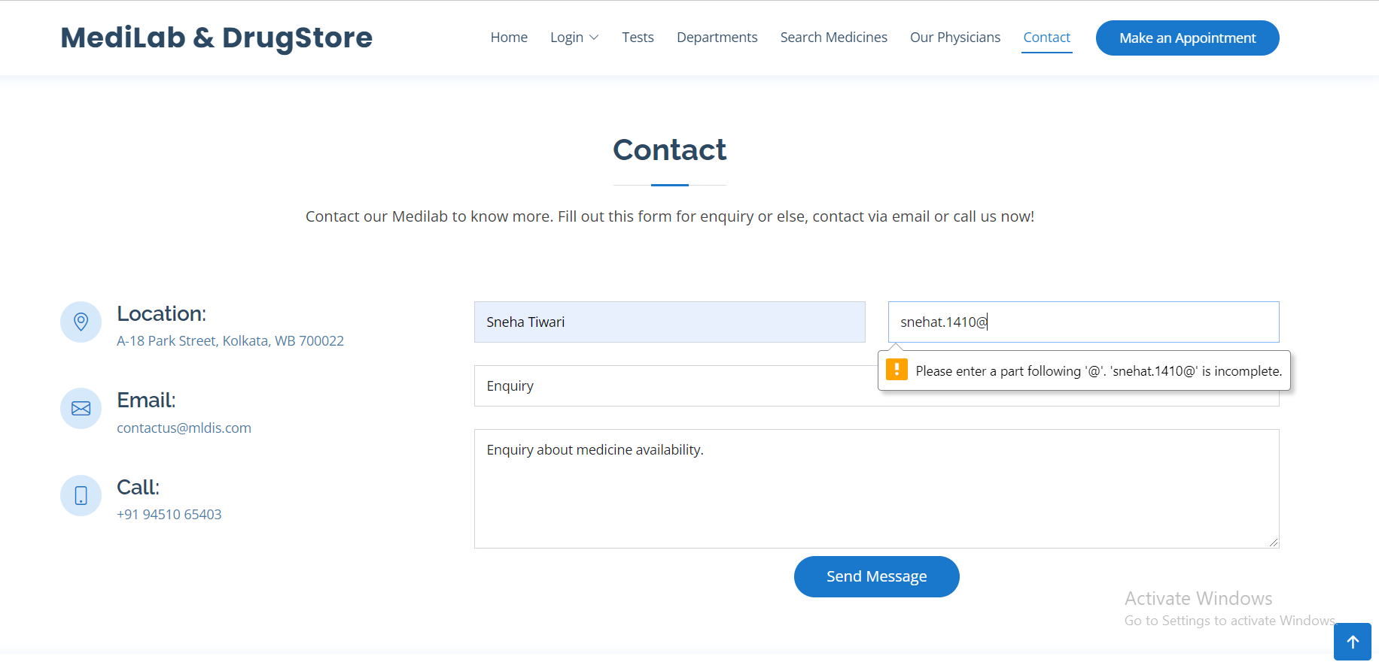
3) CONTACT & SUPPORT

Slide 9
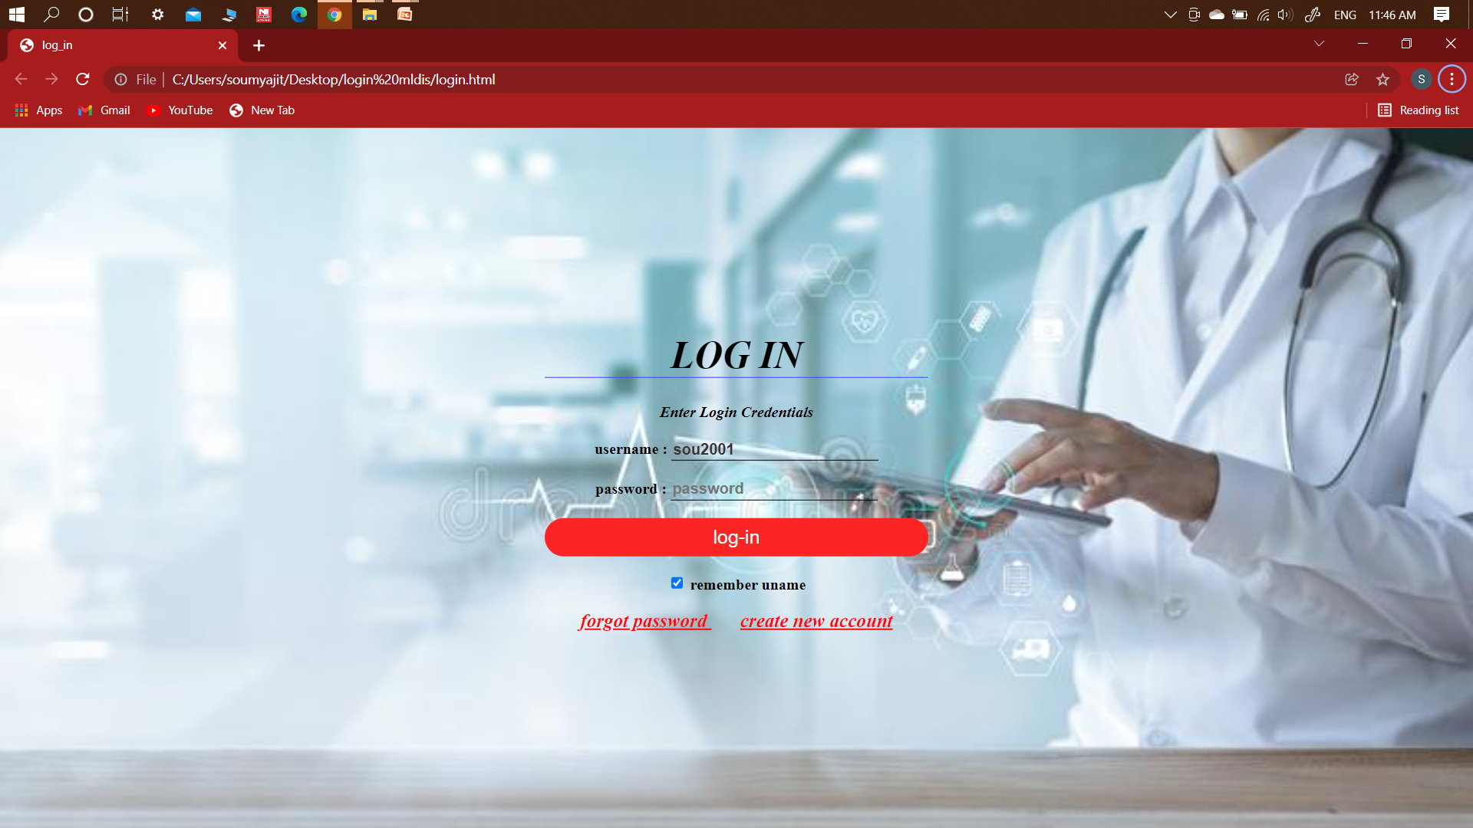
4) LOGIN

Slide 10
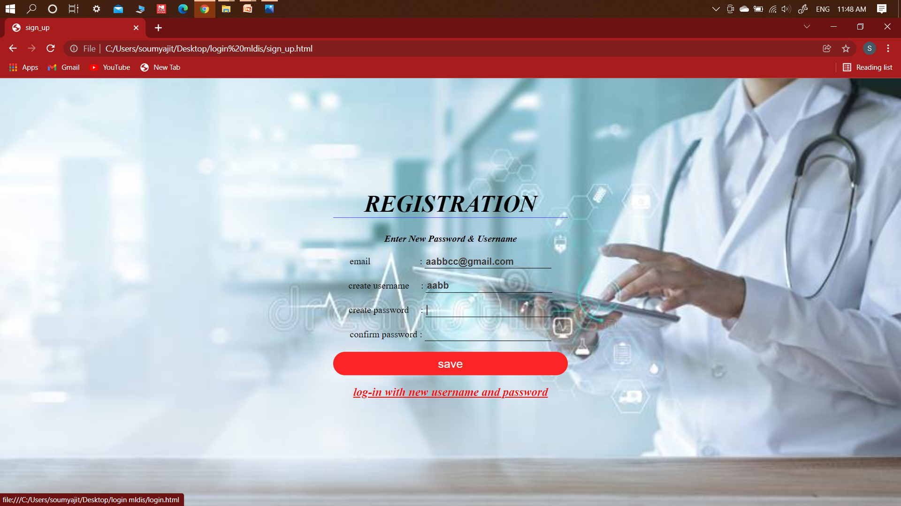
5) REGISTRATION

Slide 11
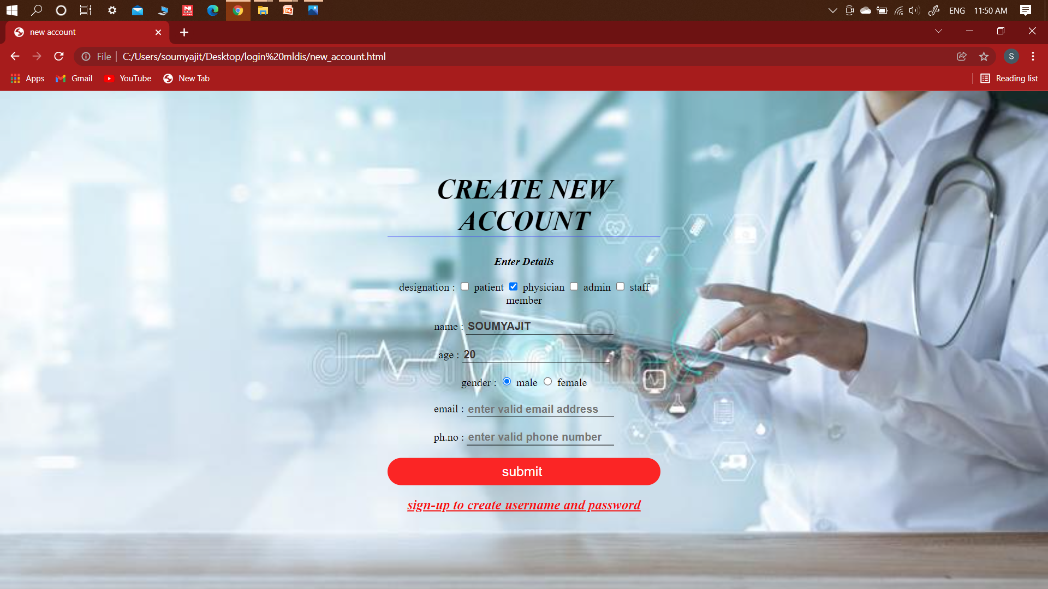
CONTINUED ..

Slide 12
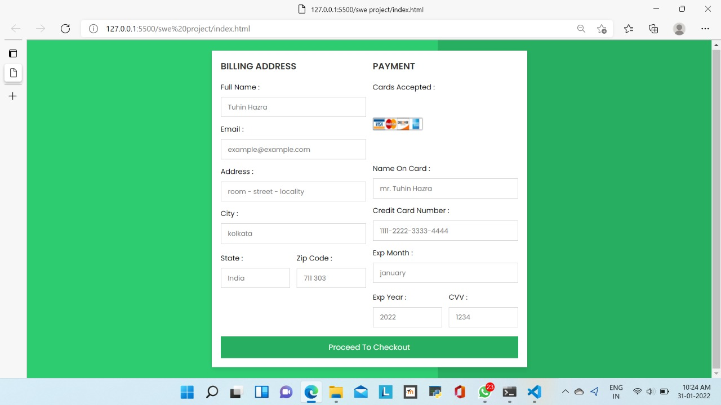
6) PAY BILL

Slide 13
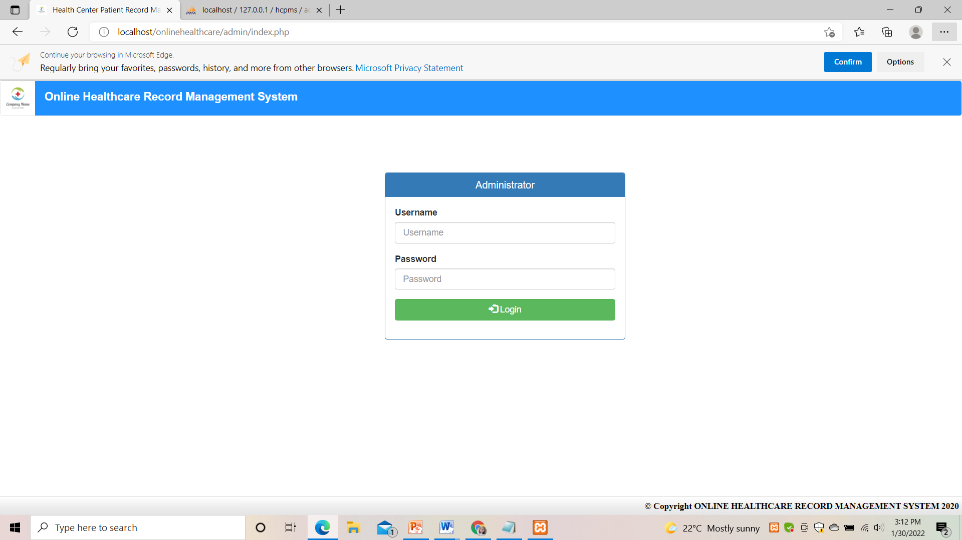
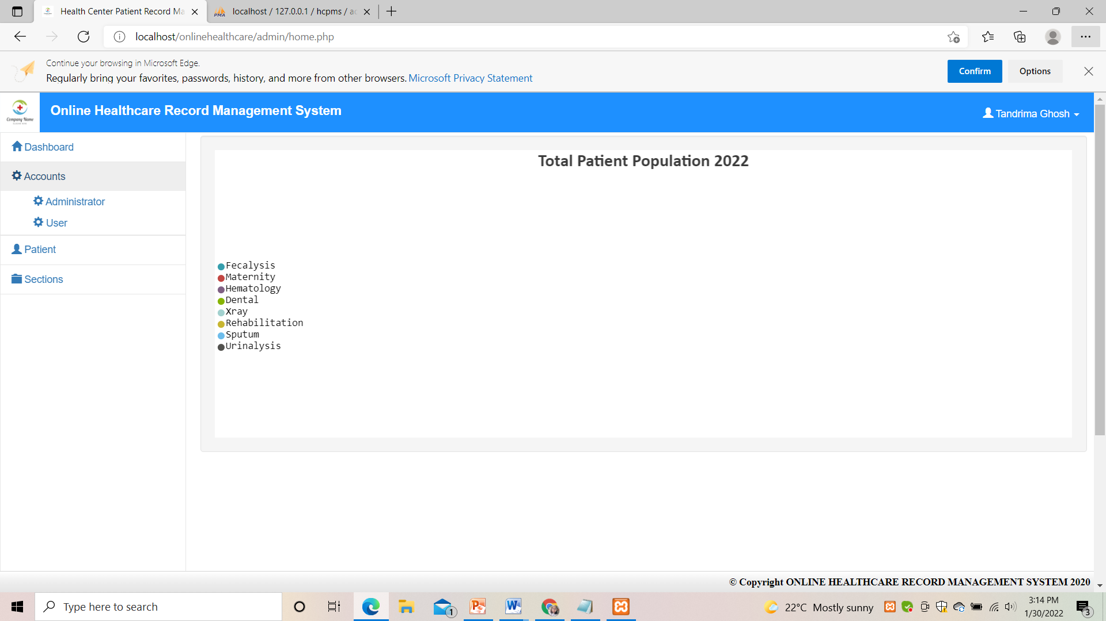
7) MANAGE PATIENT RECORD

Slide 14
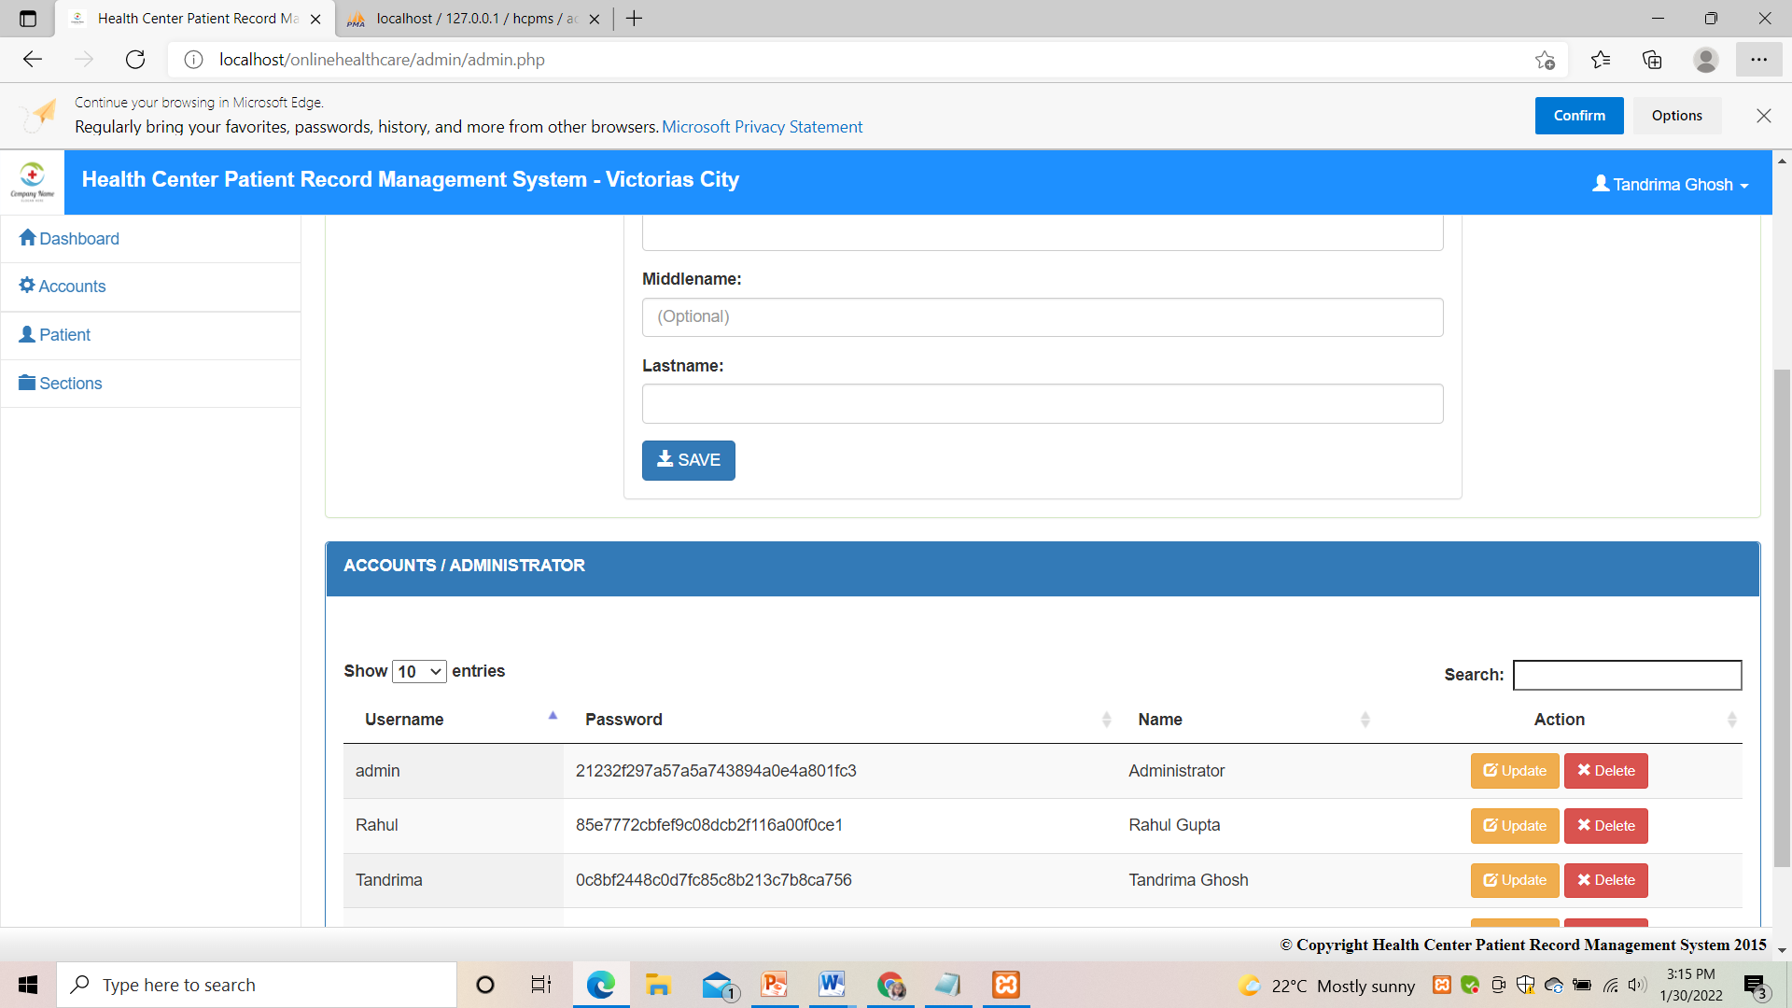
CONTINUED ..

Slide 15
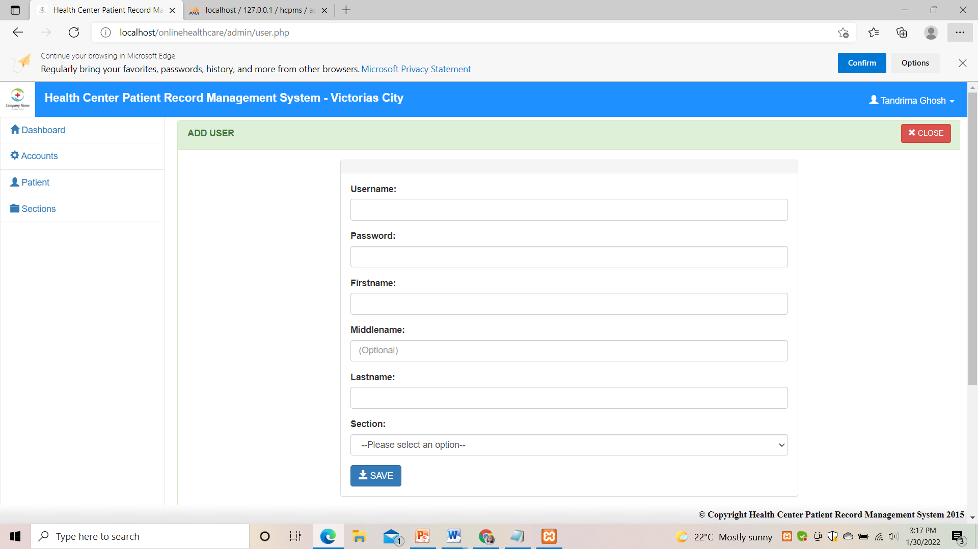
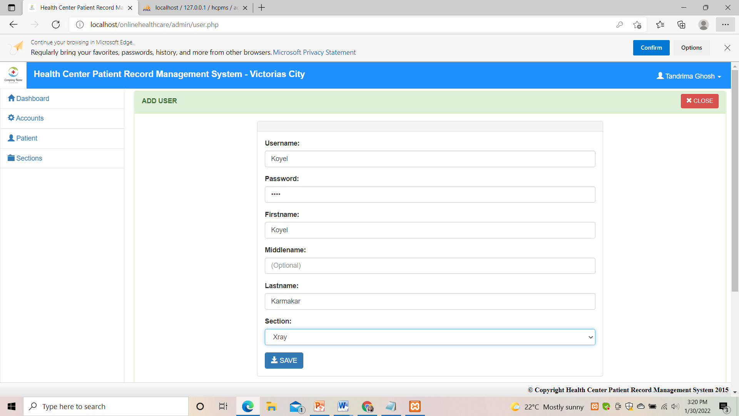

Slide 16
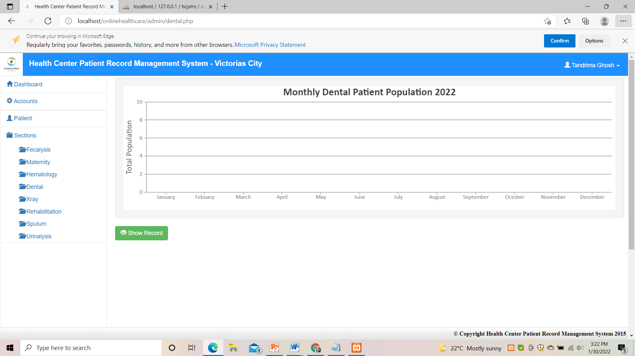

Slide 17
Thank You!

